Slide 2

Cybersecurity
Tools and procedures you can use to protect your County's private data

Slide 3
Introductions

Slide 4

ND Cyber Operations Center
Analysis & Response
Infrastructure
Active Defense
Notes:
Analysis and Response - Use Case and Playbook Development, Incident Response, Forensics, Malware Analysis, Threat Hunting, Purple Teaming
Infrastructure - Asset Inventory, Security Tools Deployment and Support, Vulnerability Management, Endpoint/Network Protection and Detection, Log Management, Architecture
Active Defense – Penetration Testing, Web Application Testing, Exploitation Analysis, Threat Intelligence, Reverse Engineering, Content Engineering, Dark Web Monitoring, Automation, JCSOC

Slide 5

Outreach and Education
Develops Defend.ND.gov
Outreach to classrooms and business communities
Works with EduTech to support K-20W initiative
Builds a community and culture around cybersecurity in North Dakota
  ND CyberCon - Tuesday, October 5, 2021
  CyberStart
  CyberPatriot
  State Wide Cyber Tournaments

Slide 6

Governance Risk and Compliance
Cyber Risk Management
Policy/Procedure/Standards
Compliance with Federal and Industry Regulation
Information Security Officer Liaisons

Slide 7
North Dakota Threat Environment

Slide 8
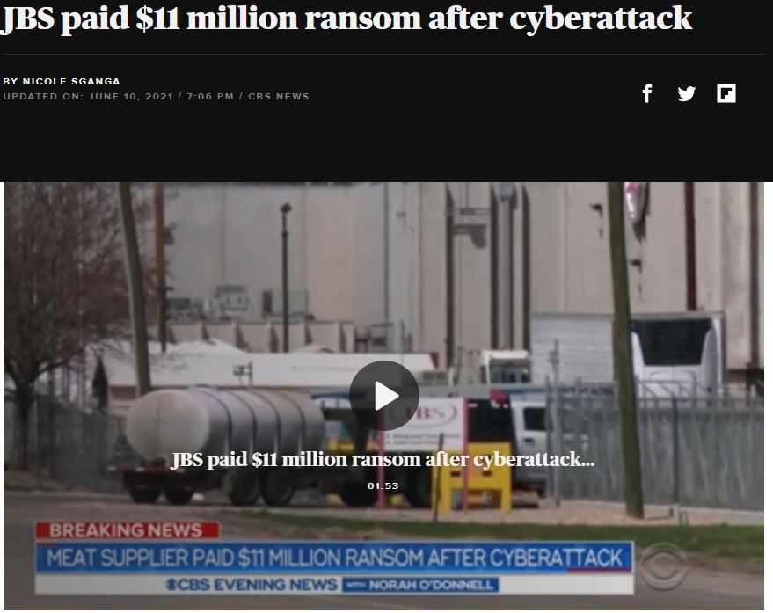
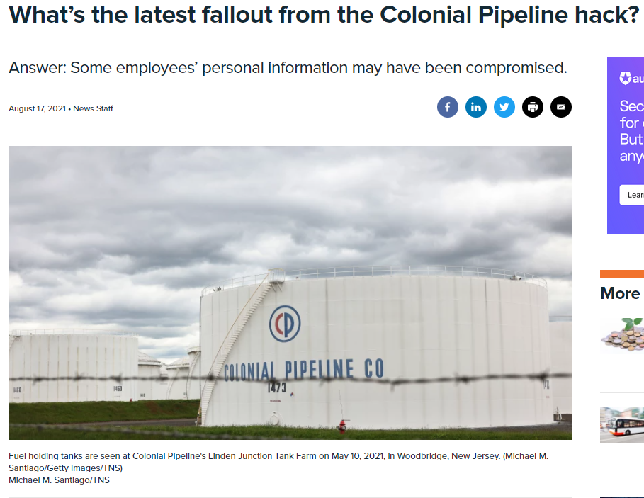
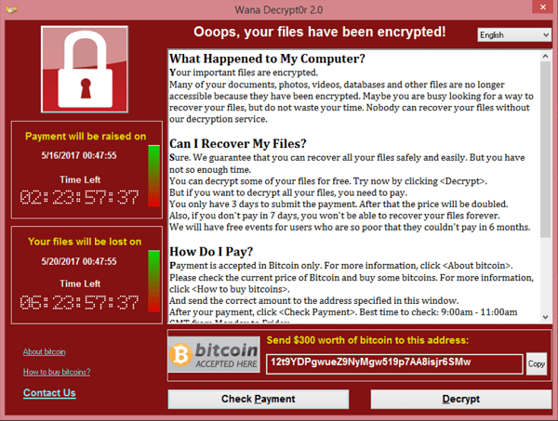
Threats and Concerns: Ransomware in Supply Chain
Ransomware has been an ongoing threat in supply chain
Energy
Agriculture

Slide 9
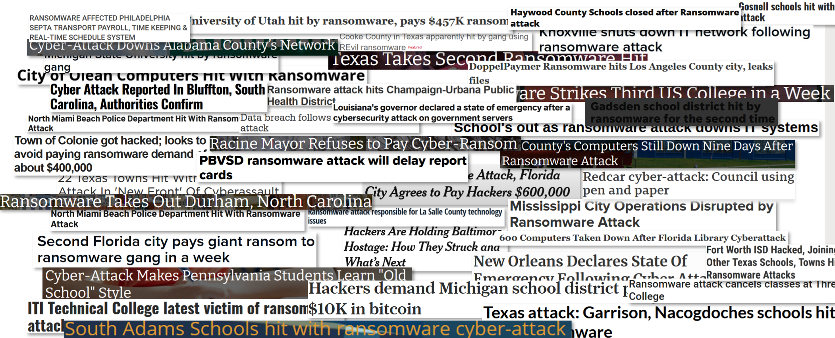
Threats and Concerns: Ransomware
Notes:
Conti
Fuxsocy
Ryuk
Maze
REvil

Slide 10
Ransomware / Extortion Attacks
The global threat of ransomware
  Since 2016, over 4,000 ransomware attacks have happened daily in the U.S. (Justice Dept)
  37% of respondents’ organizations were affected by ransomware attacks in the last year (Sophos, 2021)
  In 2021, the largest ransomware payout was made by an insurance company at $40M, setting a world record (Business Insider, 2021)
SLTT/Government
  In 2020, 33% of attacks on governmental bodies were ransomware (Security Intelligence, 2020)
  A ransomware attack against a Southern city in 2020 cost over $7M (MSSPAlert, 2020)
  A ransomware attack struck an East coast city in 2019 and caused a loss of over $18M (Baltimore Sun, 2019)
  In 2019, attacks against municipalities increased 60% from the year before (Kaspersky Labs, 2019)
Notes:
Since 2016, over 4,000 ransomware attacks have happened daily in the U.S.
37% of respondents’ organizations were affected by ransomware attacks in the last year. (Sophos, 2021)
In 2021, the largest ransomware payout was made by an insurance company at $40 million, setting a world record. (Business Insider, 2021)
In 2020, 33% of attacks on governmental bodies were ransomware (Security Intelligence, 2020)
A ransomware attack against a Southern city in 2020 cost over $7 million. (SC Magazine, 2020) – New Orleans
A ransomware attack struck an East coast city in 2019 and caused a loss of over $18 million. (Baltimore Sun, 2019) - Baltimore
81 Ransomware Statistics, Data, Trends and Facts for 2021 | Varonis

Slide 11
Ransomware / Extortion Attacks
Things will likely get worse.
  Driven by organized crime
  Well-developed monetary ecosystem around these attacks
  Every successful attack gives ransomware groups bigger budgets
  Bigger budgets means more of an ability to develop or buy better exploits and tools
https://doublepulsar.com/the-hard-truth-about-ransomware-we-arent-prepared-it-s-a-battle-with-new-rules-and-it-hasn-t-a93ad3030a54
Notes:
Monetization – There is a very well-developed money ecosystem around these attacks.
For example:
monetization of obtaining initial access to a device
monetization of selling that access
monetization of marketplaces to buy and sell access to organization’s networks
monetization of buying/selling offensive tools to add malicious macros to office documents or tools to evade AV/EDR solutions
monetization of selling and reselling remote access trojans and botnets
monetization of selling ransomware software and ransomware-as-a-service platforms
monetization of hiring developers and staff for developing all of the above tools and platforms

Slide 12
Phishing Attacks

Slide 13
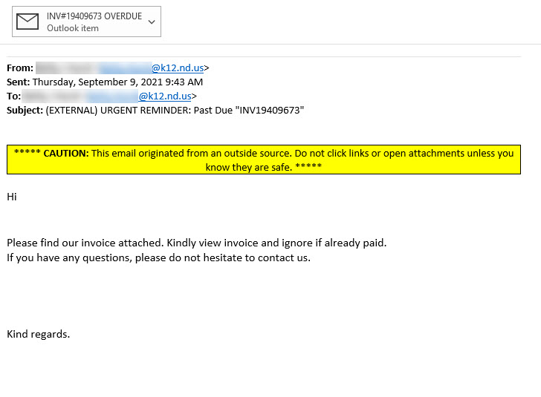
Notes:
This is an actual phishing email received last week by a City Auditor. An untold number of emails like this one are being sent to unsuspecting receipts every day in North Dakota.

Slide 14

Phishing –
What is it?
Type of social engineering attack that uses email to fool you into taking an action you should not take, such as
  Clicking on a malicious link
  Sharing your password
  Opening an infected email attachment.
Phishing emails can be very convincing and often utilizes emotional triggers to create a sense of urgency or spark your curiosity.
Notes:
Type of social engineering attack that uses email to fool you into taking an action you should not take, such as
Clicking on a malicious link
Sharing your password
Opening an infected email attachment.
Phishing emails can be very convincing and often utilizes emotional triggers to create a sense of urgency or spark your curiosity.

Slide 15

Phishing –
How to identify?
Look for Red Flags within:
  From Address - Do you normally communicate?
  To Address - Are you the only recipient? Are you listed?
  Hyperlinks - Hover over to check
  Date/Time - 4 am or business hours?
  Subject
  Attachments - Do you normally get attachments from this person?
  Content
    Was it written in proper English?
    Is it asking you to take action?
Notes:
Remember your training! Look for red flags in emails. Will be working with Service Desk to share a hand-out on Social Engineering Red Flags.
FROM
I don’t recognize the sender’s email address as someone I ordinarily communicate with.
This email is from someone outside my organization and it’s not related to my job responsibilities.
This email was sent from someone inside the organization or from a customer, vendor, or partner and is very unusual or out of character.
Is the sender’s email address from a suspicious domain (like micorsoft-support.com)?
I don’t know the sender personally and they were not vouched for by someone I trust.
I don’t have a business relationship nor any past communications with the sender.
This is an unexpected or unusual email with an embedded hyperlink or an attachment from someone I haven’t communicated with recently.
TO
I was cc’d on an email sent to one or more people, but I don’t personally know the other people it was sent to.
I received an email that was also sent to an unusual mix of people. For instance, it might be sent to a random group of people at my organization whose last names start with the same letter, or a whole list of unrelated addresses.
HYPERLINKS
I hover my mouse over a hyperlink that’s displayed in the email message, but the link-to address is for a different website. (This is a big red flag.)
I received an email that only has long hyperlinks with no further information, and the rest of the email is completely blank.
I received an email with a hyperlink that is a misspelling of a known website. For instance, www.bankofarnerica.com — the “m” is really two characters — “r” and “n.”
DATE
Did I receive an email that I normally would get during regular business hours, but it was sent at an unusual time like 3 a.m.?
SUBJECT
Did I get an email with a subject line that is irrelevant or does not match the message content?
Is the email message a reply to something I never sent or requested?
ATTACHMENTS
The sender included an email attachment that I was not expecting or that makes no sense in relation to the email message. (This sender doesn’t ordinarily send me this type of attachment.)
I see an attachment with a possibly dangerous file type.
CONTENT
Is the sender asking me to click on a link or open an attachment to avoid a negative consequence or to gain something of value?
Is the email out of the ordinary, or does it have bad grammar or spelling errors?
Is the sender asking me to click a link or open up an attachment that seems odd or illogical?
Do I have an uncomfortable gut feeling about the sender’s request to open an attachment or click a link?
Is the email asking me to look at a compromising or embarrassing picture of myself or someone I know?

Slide 16
Notes:
Some red flags- the “To” didn’t list the city auditor’s email account. This is likely because this same phishing email and attachment was sent to a large group of people, who were blind CC. Blind CC is used for very legitimate proposes, like sending a public notification to larger group of interested individuals. But an invoice would be specific to a single entity, so there is no good reason to send it this way.
Another red flag – “please do not hesitate to contact us”, but no contact information was provided.
On this specific email, once the attachment is opened, it takes the victim to a Microsoft log in page that prompts the user to provide their username and password. Then, the last step of this attack is a payment portal, that presents a realistic appearing invoice, typically for a fairly small dollar amount and place to provide credit card information.
So what is this attacker after? In this scenario, the attacker is very hopeful that you will provide a credit card number. However, even if you don’t provide a credit card number, you have already provided the attacker with something very valuable – your username and password, also called credentials, are the keys to the kingdom.
Now that the attacker has your username and password, they can log into your email account and launch a brand-new phishing attack. The victims of this new attack? All the people in your address book.
They could also poke around in your email to see what other accounts you might have registered using the same email account. Because people commonly reuse passwords this could give the attacker access to your bank or financial institution, Walmart, Amazon, Fedex, UPS, etc.

Slide 17
Best Practices

Slide 18
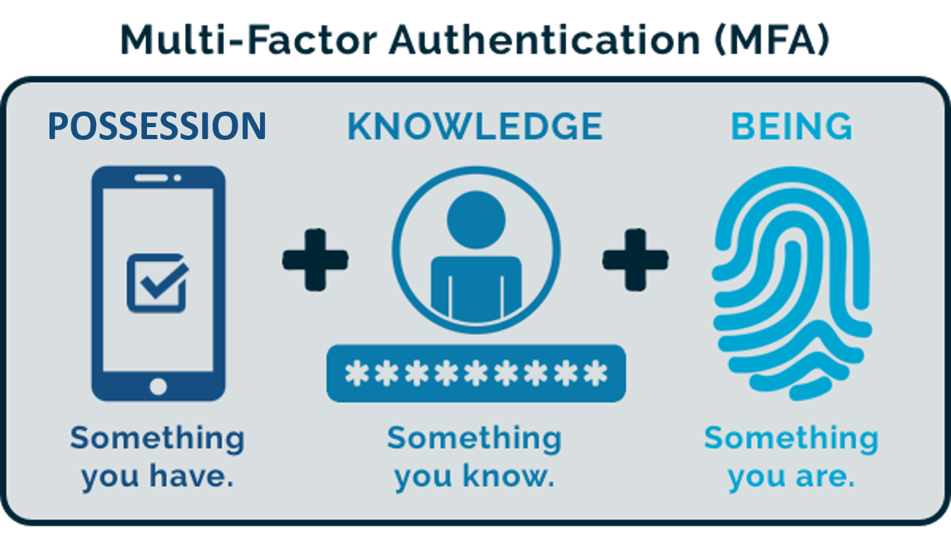
Notes:
Two-factor authentication
Adding two-factor authentication is a far more secure solution than relying on just passwords alone. It works by requiring not one but two different methods to authenticate yourself. This way if your password is compromised, your account is still protected. One example is your ATM card; when you withdraw money from an ATM machine, you are actually using a form of two-factor authentication. To access your money, you’ll need two things: your ATM card (something you have) and your PIN number (something you know). If you lose your ATM card, anyone who finds your card cannot withdraw your money as they do not know your PIN. The same is true if they only have your PIN and not the card. An attacker must have both to compromise your ATM account. The concept is similar for two-factor authentication; you have two layers of security.

Slide 19
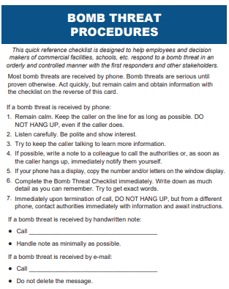
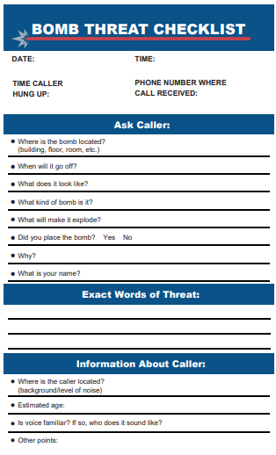

Create a Plan
Notes:
Create a plan
Does anyone remember these?
Create a similar document that can be used in case of a cybersecurity incident

Slide 20
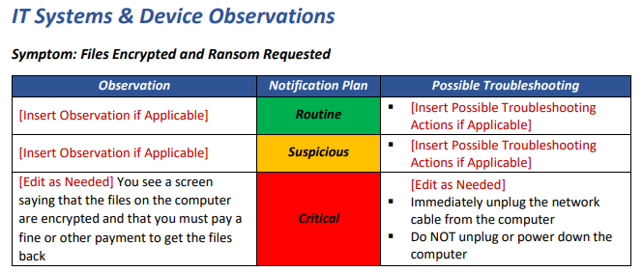
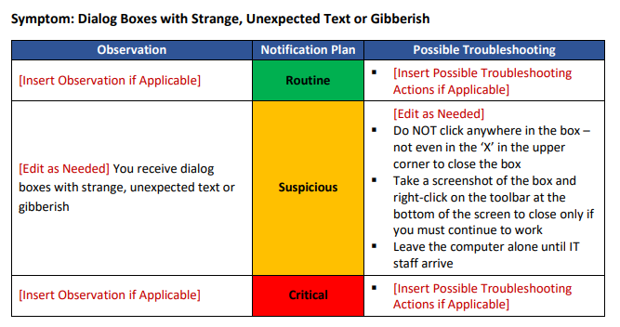
Create a Plan
Notes:
This is just one example of what can be created – but it doesn’t even need to be this complex
Stick to the basics-
What happened
Did you click a link or open an attachment
Did you provide a user name or password
Did you get a pop up box or a notification from your anti-virus software
WHO TO CALL
We are working on templates that can be sized and scaled for jurisdictions of all sizes.

Slide 21
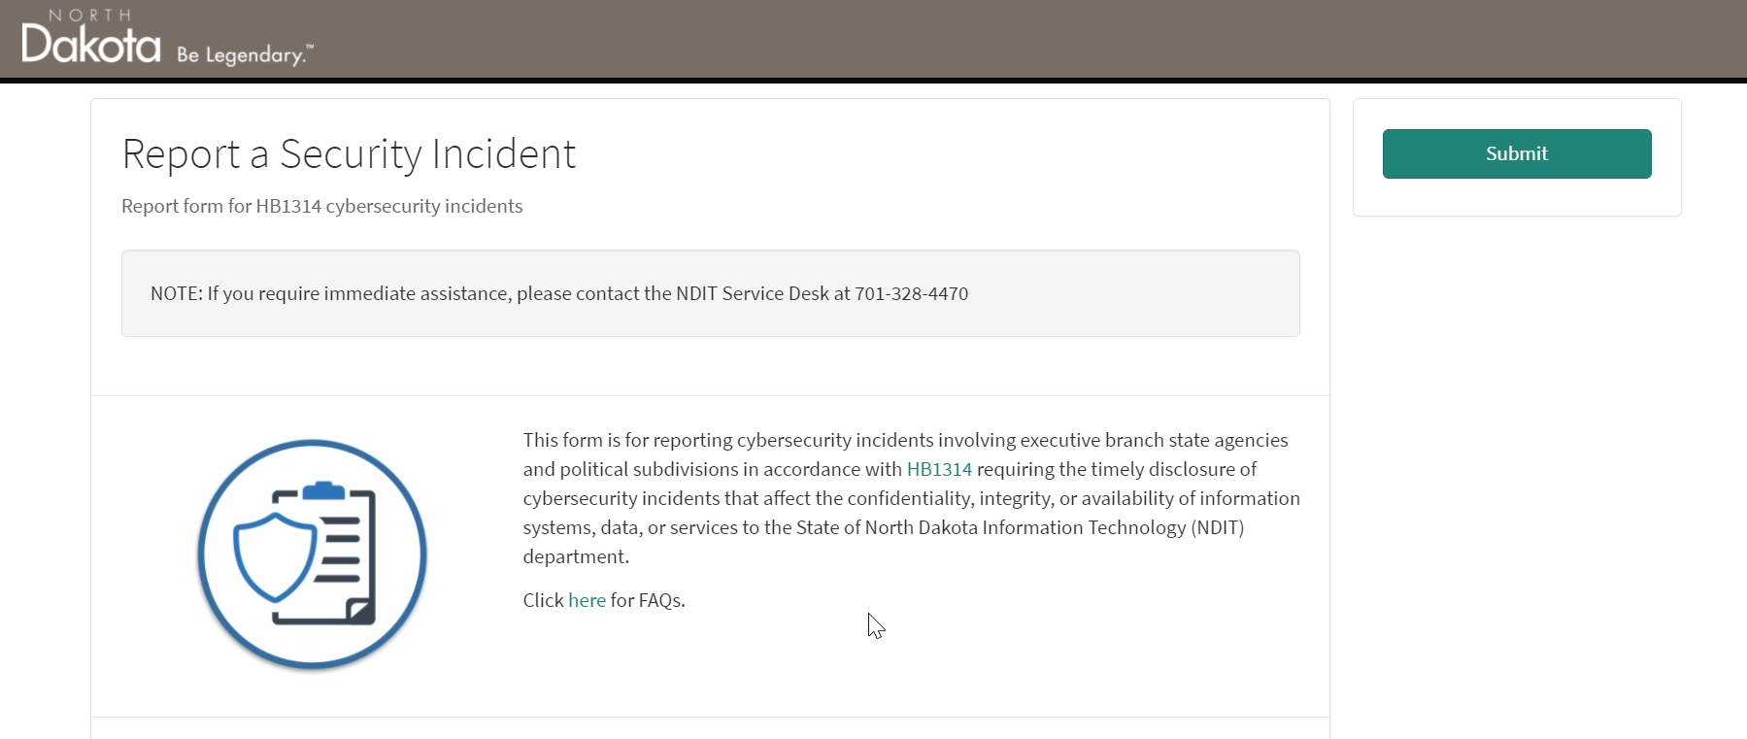
Cybersecurity Incident Reporting
https://northdakota.service-now.com/public?id=security_incident
Notes:
What about a major incident, like ransomware or a malware infection?
Follow your plan!
Report the incident to NDIT
A new law enacted during the most recent legislative session requires the timely reporting of cybersecurity incidents to the North Dakota Information Technology (NDIT) department.
This law pertains to cyber incidents that affect the confidentiality, integrity, or availability of information systems. As part of the new law, NDIT is tasked with developing a reporting method and communicating that method to you.
The NDIT Cybersecurity Incident Reporting form can be found here.
This new law also allows, at your request for us to provide additional assistances to help you recover from the cybersecurity incident.

Slide 22
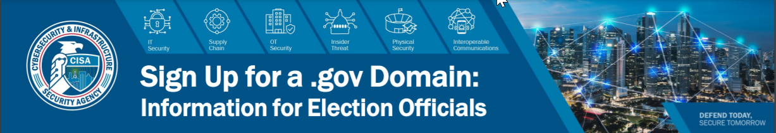

.gov is Secure
.gov is Trusted
.gov is Authoritative
.gov Domain
Notes:
.gov is Secure
Cybersecurity & Infrastructure Security Agency (CISA), part of the US Department of Homeland Security (DHS) oversees the security of the .gov infrastructure and facilitates reporting of potential security incidents to your domain points of contact
Unlike any other top-level domain (TLD), CISA conduct HSTS preloading, ensuring use of HTTPS servers, reducing your chances of being phished or routed through a foreign website
.gov is Trusted
CISA manage the .gov TLD, which is exclusive to U.S. government organizations
CISA support all official U.S. government organizations, including federal, state, city, and county governments, native sovereign nations (NSN), and interstate and independent intrastate government organizations
A .gov domain name lends legitimacy to your websites and online tools, and helps your customers trust that your content is official
.gov is Authoritative
CISA host the .gov domain registry and registrar, where .gov domains are housed & managed
CISA serve as the policy authority for .gov, overseeing the issuance of .gov domain names, i.e., evaluating each registrant’s authority over, and eligibility for, a given domain name
CISA arbitrate name exception requests, set requirements for a domain name’s continued use, and facilitate name transfers

Slide 23
Security Awareness Education

Slide 24

Security Awareness Education
90% plus of all data breaches begins with a phishing campaign
Phishing campaigns
  Crucial Education
  Real world examples of today’s phishing threats
  Phish Alert Button
Security Training Campaigns
  New Hire 45 Mins with Quiz
  Annual training 15 – 30 Mins in length with Quiz
  Microburst quarterly education courses are roughly 5 minutes in length
  KnowBe4 training portal

Slide 25
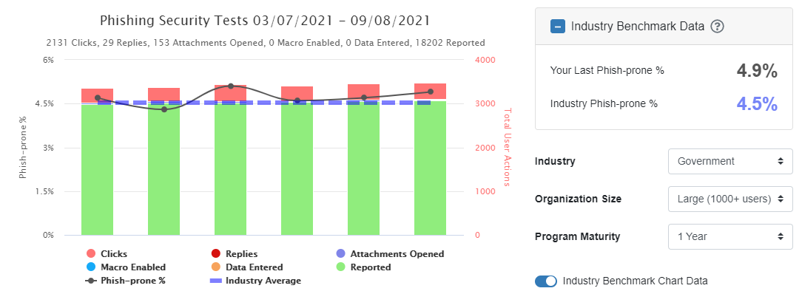

Slide 26

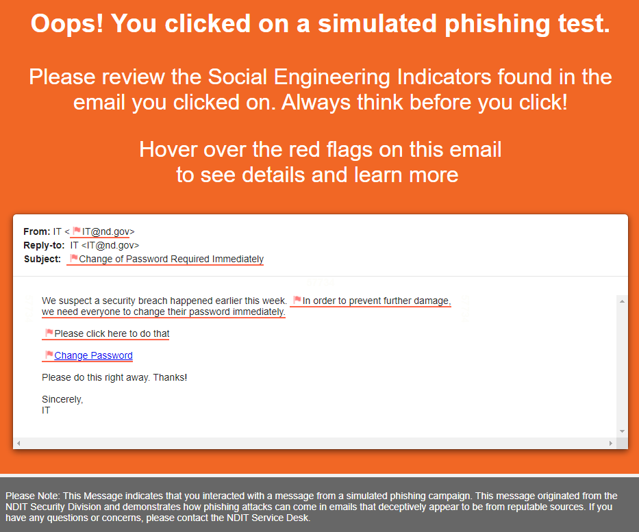


Slide 27
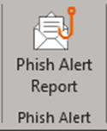
Phish Alert Server Side
Pushed via Exchange Server
  Exchange Online
  Office 365
Phish Alert button available on Webmail and Microsoft Outlook app for iOS and Android
PAB uses Preview Pane or opening email
  Remember opening a Phish Campaign NOT equal failure
Shared Mailboxes
  Copy email to user’s inbox and report
  Forward to itdkb4phish@nd.gov
Notes:
As PAB advances, not evaluating an email at all does not education our team members to identify phish emails.

Slide 28
Phish Campaign Culture
It’s Education, NOT Punishment nor Embarrassment
Supplying ND Team Members with the tools to protect themselves
If individuals feel in “trouble” or “embarrassed” when clicking a phishing campaign …
  Why would they report real world phishing failures?

Slide 29
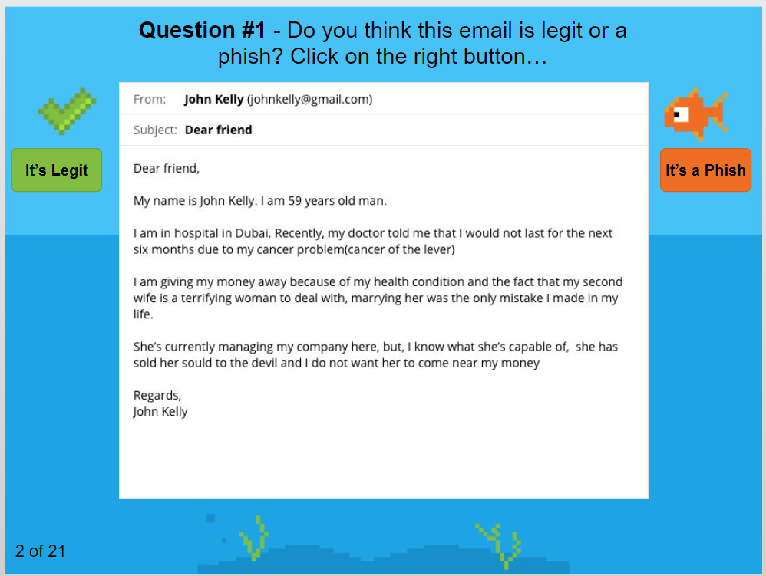
Security Training Campaigns
Very Interactive
Video Training Modules
Episodic Series – Inside Man
Games
Weekly Reminders
Manager Reminders

Slide 30
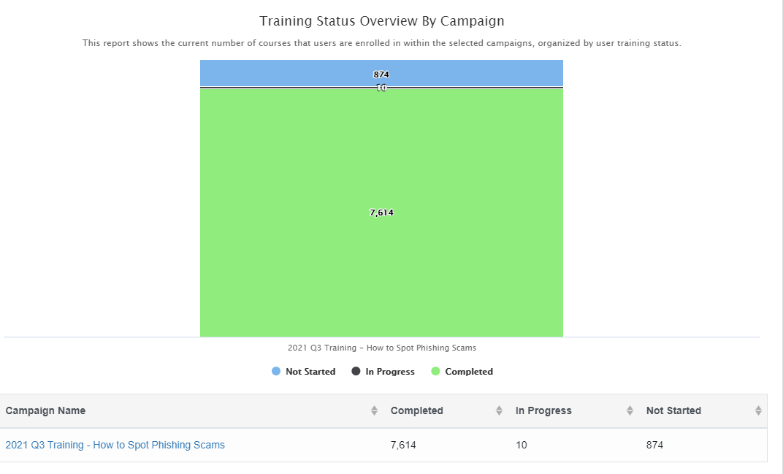
Security Education Campaigns

Slide 31
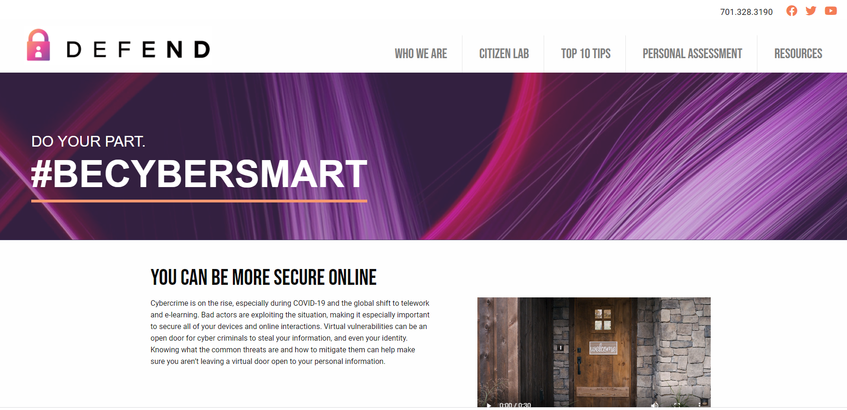

Slide 32
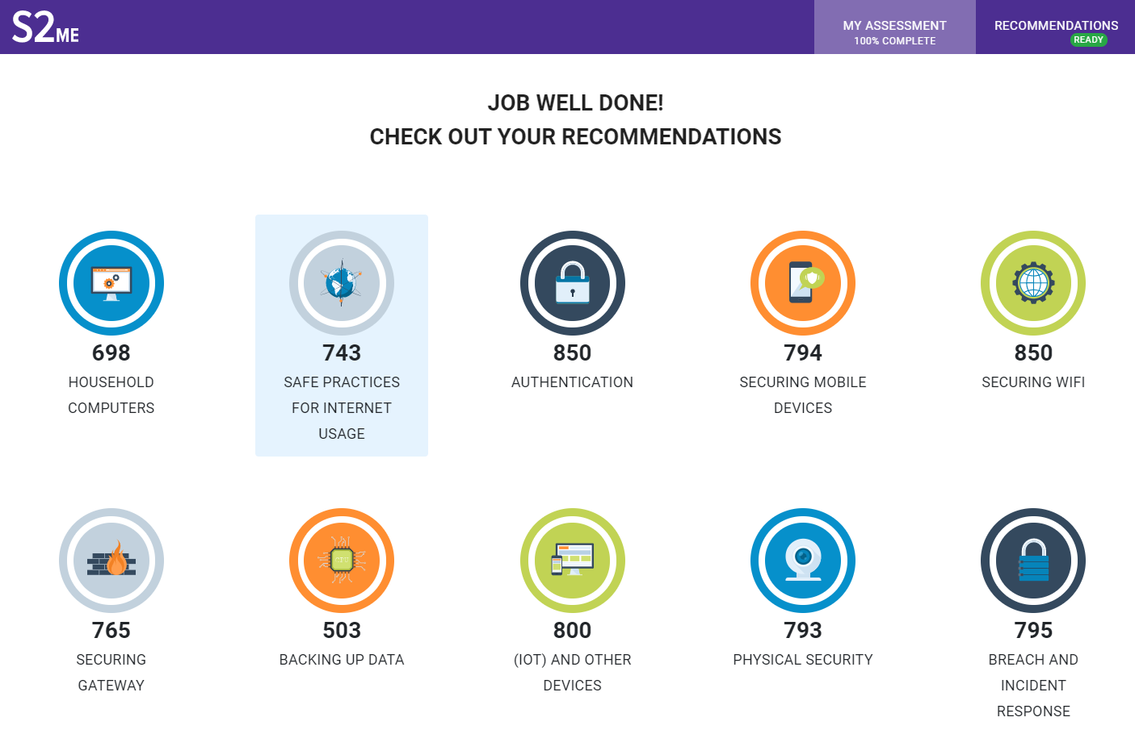

Slide 33
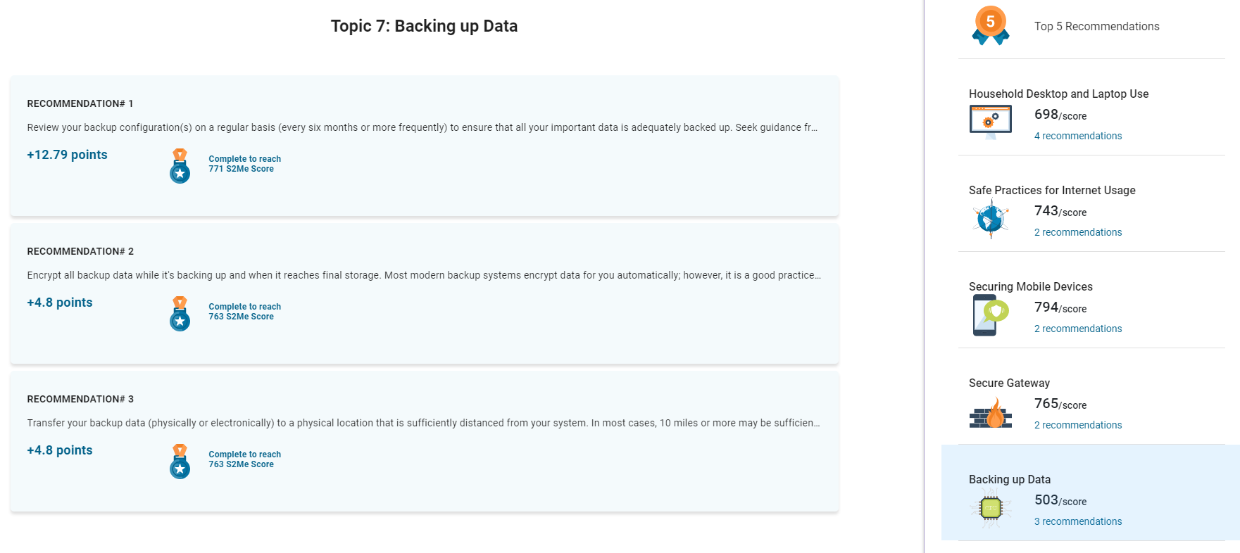

Slide 34
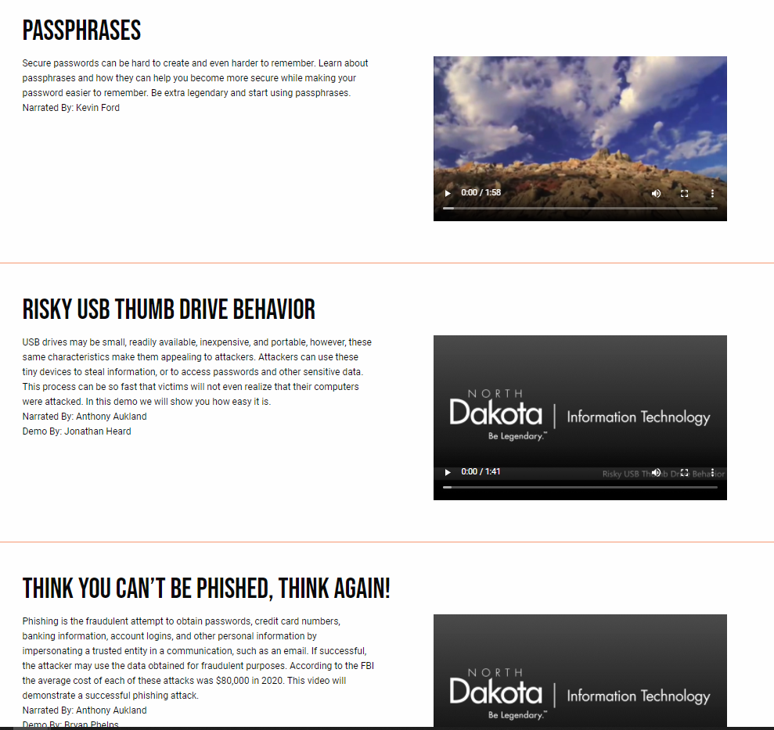

Slide 35
NDIT Services – No Cost!

Slide 36




Notes:
NDIT provides no-cost tools to organizations that can help in the remediation and protection of your systems. These tools allow NDIT to work with your organization to clean malicious files, address vulnerably and investigate the incident. We recommend reaching out to NDIT to install:
Palo Alto Cortex XDR Advanced Endpoint Protection (AEP) Antimalware software
Clients available for Windows, macOS, and Chromebook devices
Proactively protects devices from malware and malicious activity
Nessus Tenable Vulnerability software scanning tool
Clients available for Windows and macOS devices
Scans, identifies all software, including 3rd party, on each device reports vulnerabilities and recommends actions for remediation

Slide 37

Advanced Endpoint Protection (AEP) Antimalware software
Proactively protects devices from malware and malicious activity
Team NDIT actively monitors systems
System access at the local level
Available for Windows, macOS, and Chromebooks
Submit a ticket to the NDIT Service Desk
Available at no cost to counties
Notes:
NDIT provides no-cost tools to organizations that can help in the remediation and protection of your systems. These tools allow NDIT to work with your organization to clean malicious files, address vulnerably and investigate the incident. We recommend reaching out to NDIT to install:
Palo Alto Cortex XDR Advanced Endpoint Protection (AEP) Antimalware software
Clients available for Windows, macOS, and Chromebook devices
Proactively protects devices from malware and malicious activity
Nessus Tenable Vulnerability software scanning tool
Clients available for Windows and macOS devices
Scans, identifies all software, including 3rd party, on each device reports vulnerabilities and recommends actions for remediation

Slide 38

Scans, identifies all software, including 3rd party, on each device
Reports vulnerabilities and recommends actions for remediation
Dashboards to easily see most critical vulnerabilities
Clients available for Windows and macOS devices
Submit a ticket to the NDIT Service Desk
Available at no cost to counties

Slide 39
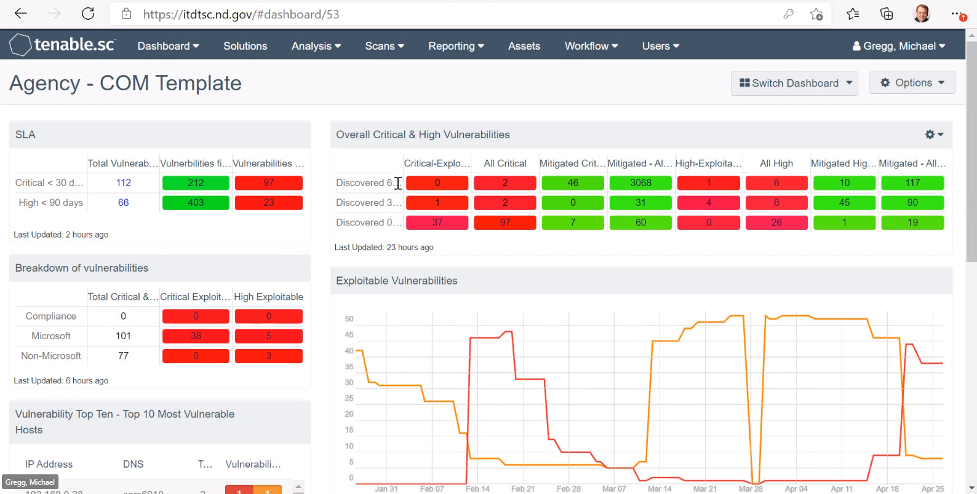

Slide 40

Dark Web Monitoring for sites that have been breached
Notification of Leaked Credentials for your Domain
Submit a ticket to the NDIT Service Desk
Available at no cost to counties

Slide 41

End-User Cybersecurity Training
Simulated Phishing Attacks
Phishing Report Button for Outlook
Submit a ticket to the NDIT Service Desk
Available at no cost to counties

Slide 42
Security Q&A

Slide 43
Contact us
For more information or to request any products or services discussed today contact the NDIT Service Desk
Website: Northdakota.service-now.com/serviceportal
Phone: 701-328-4470
Jessica Newby – Information Security Officer
Email: jnewby@nd.gov
Phone: 701-328-4395

